Slide 1
Predicting Heart Disease in Seniors based on fruit intake
Rushabh Rambhia

Slide 2
Hypothesis
Seniors who eat more fruit on a regular basis have lesser chances of having heart disease

Slide 3
Previous Studies
I found two previous studies on this topic
Study 1: Published in 2002 in American Society of Clinical Nutrition
This study concluded that there was an inverse association of fruit and vegetable intake with the risk of cardiovascular disease in general US population
Conducted on time series data for 9,608 adults and data was collected from 1971 to 1975
Study 2: Published in 1996 in JAMA
This study concluded that there was an inverse association between fiber intake and Myocardial Infarction in male health professionals

Slide 4
How is my study different?
Focus on Seniors (65+)
Cross Sectional Data
Data Source: BRFSS
Feature of interest is Fruit Intake (will not be using vegetable intake)
Include other variables that could impact either Fruit Intake or Heart Disease in seniors
Outcome is Categorical ie Heart Disease = Y or N
Use of machine learning algorithms

Slide 5
Data Source Overview
2015 BRFSS Data set
Cross Sectional data
Over 441,000 people interviewed across 50 states in US
Each interviewee answered over 120 mandatory and optional questions about their habits and chronic conditions
Data feed available in txt as well as SAS format
Data size is little less than 1 GB

Slide 6
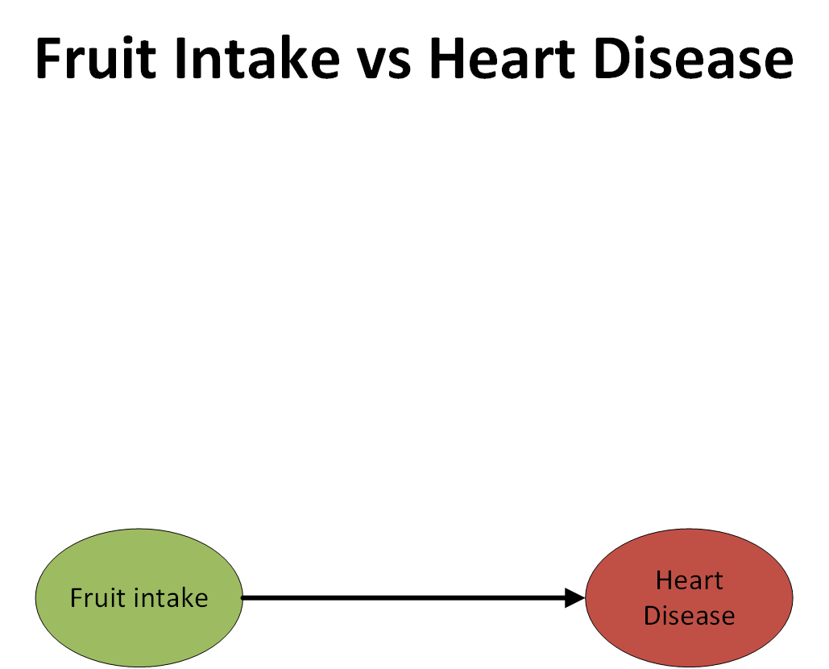

Slide 7
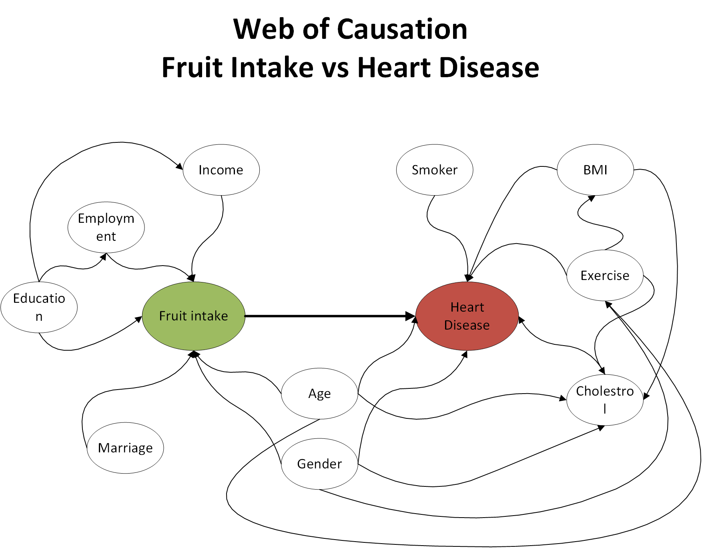

Slide 8
Data Exploration
Total records: 441,456
Senior records (over 65 years of age): 150,460
Senior records without nulls: 131,988
Seniors that reported having Heart Disease = 22,500
Seniors that did not report Heart Disease (including those who refused or did not know) = 109,488

Slide 9
Outcome Variable: _MICHD
Original variable name: _MICHD
1 = Y
2 = N
Encoded variable: HD
0 = N
1 = Y

Slide 10
Feature: FRUITDA1_ Fruit servings per day
HD = 1
HD = 0
count 225,00
mean 90
std 106
min 0
25% 33
50% 86
75% 100
max 9,900
count 109,488
mean 102
std 116
min 0
25% 43
50% 100
75% 100
max 9,900

Slide 11
Feature: FRUITDA1_ Excluding values > 500 (217 records excluded)
HD = 1
HD = 0
count 22,466
mean 88
std 77
min 0
25% 33
50% 86
75% 100
max 500
count 109,305
mean 100
std 83
min 0
25% 43
50% 100
75% 100
max 500

Slide 12
Next Steps
Do more research on Fruit Intake feature
Encode dummy variables for Gender, Income, Education, Marriage, Exercise
Decide whether to impute or leave out missing data
Apply logistic regression and calculate accuracy

